Slide 1

Stored Procedures in MS-SQL Server
Soyeb Ghachi
Technical Trainer | Mentor |SME

Slide 2
Stored Procedures in MS-SQL Server
Creating a simple stored procedure
Modifying a Stored Procedure
Deleting a Stored Procedure
Parameterzied Stored Procedure
Output Parameters
Exception Handling
Overview

Slide 3
Stored Procedures in MS-SQL Server

Slide 4
A SQL Server stored procedure groups one or more Transact-SQL statements into a logical unit and is stored as an object in the Database Server.
When a stored procedure is called at the first time, SQL Server creates an execution plan and stores it in the plan cache.
In the subsequent executions of the stored procedure, SQL Server reuses the plan so that the stored procedure can execute very fast with reliable performance.
CREATE | ALTER |DROP PROCEDURE [schema_name.]procedure_name
@parameter1 datatype1,
@parameter2 datatype2,
...
AS
BEGIN
-- SQL statements and logic go here
END;

Slide 5
Advantages of using Stored Procedures

Slide 6
Improved Performance: Stored procedures are precompiled and stored in the database, which can result in improved performance. Once compiled, they are executed more efficiently than ad hoc SQL statements, reducing the overhead of query parsing and optimization.
Reduced Network Traffic: With stored procedures, the execution logic is processed on the server side. Only the procedure name and input/output parameters need to be sent over the network, reducing the amount of data transferred between the client and the server. This can lead to improved network performance and reduced latency.

Slide 7
Enhanced Security: Stored procedures provide an additional layer of security by allowing access to data through the stored procedure interface rather than granting direct table access to users. Permissions can be set at the stored procedure level, ensuring fine-grained control over data access.
Code Reusability: Stored procedures promote code reuse as they can be called from various applications or different parts of the same application. This reduces redundancy and helps maintain consistency in data processing and business logic.
Encapsulation and Abstraction: Stored procedures allow you to encapsulate complex SQL queries, business logic, and data manipulation operations into a single unit. This provides a higher level of abstraction, making it easier to understand and maintain the database logic.

Slide 8
Transaction Management: Stored procedures enable you to define and manage transactions explicitly. By encapsulating multiple SQL statements within a stored procedure, you can ensure that all the statements execute as a single unit, either committing or rolling back the changes atomically.
Version Control: Stored procedures can be versioned and tracked within the database management system. This allows for better control and management of changes to the database logic, providing the ability to roll back to previous versions if necessary.
Improved Maintainability: By separating the application logic from the database schema, stored procedures make it easier to maintain and update the database without impacting the application code. Changes to stored procedures can be made independently, reducing the need for application code modifications.

Slide 9
Performance Optimization: Stored procedures provide the flexibility to optimize database performance. By predefining the execution plan, utilizing indexing techniques, and implementing efficient query logic within stored procedures, you can enhance overall database performance.
Overall, stored procedures offer advantages such as improved performance, reduced network traffic, enhanced security, code reusability, encapsulation, and better maintainability. They provide a powerful mechanism for managing complex database operations and promoting efficient data processing.

Slide 10
Creating a Stored Procedure

Slide 11
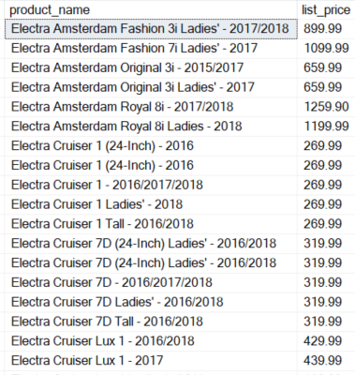
Creating a simple stored procedure:
CREATE PROCEDURE uspProductList
AS
BEGIN
SELECT
product_name,
list_price
FROM
products
ORDER BY
product_name;
END;
Executing a stored procedure
EXEC uspProductList;
uspProductList;

Slide 12
Modifying a Stored Procedure

Slide 13
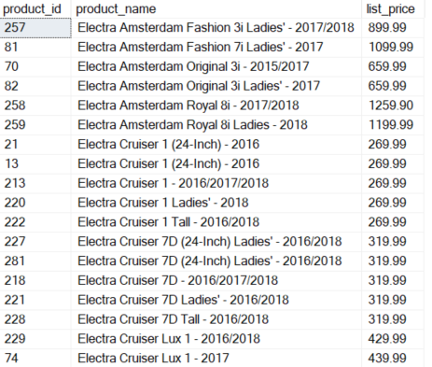
Modify a stored procedure:
ALTER PROCEDURE uspProductList
AS
BEGIN
SELECT
product_id,
product_name,
list_price
FROM
products
ORDER BY
product_name;
END;
Executing a stored procedure
EXEC uspProductList;

Slide 14
Deleting a Stored Procedure

Slide 15
Deleting a stored procedure:
To delete a stored procedure, you use the DROP PROCEDURE or DROP PROC statement
DROP PROCEDURE uspProductList;

Slide 16
Parameterized Stored Procedure

Slide 17
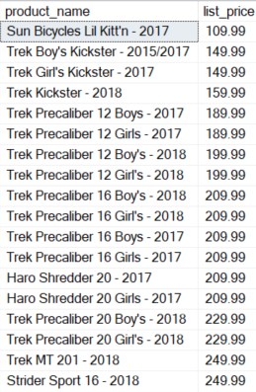
Creating a stored procedure with one parameter
CREATE PROCEDURE uspFindProducts(@min_list_price AS DECIMAL)
AS
BEGIN
SELECT
product_name,
list_price
FROM
products
WHERE
list_price >= @min_list_price
ORDER BY
list_price;
END;
Executing a stored procedure with one param.
EXEC uspFindProducts 100;

Slide 18
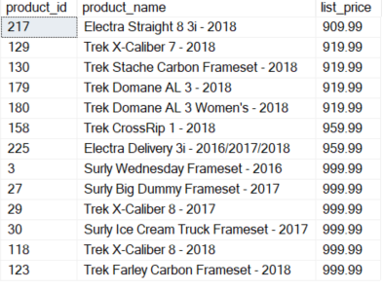
Creating a stored procedure with multiple parameters.
ALTER PROCEDURE uspFindProducts(
@min_list_price AS DECIMAL
,@max_list_price AS DECIMAL
)
AS
BEGIN
SELECT
product_id,
product_name,
list_price
FROM
products
WHERE
list_price >= @min_list_price AND
list_price <= @max_list_price
ORDER BY
list_price;
END;
Executing a stored procedure with multiple parameters.
EXEC uspFindProducts 900, 1000;

Slide 19
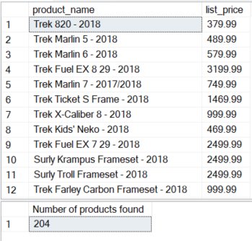
Creating output parameters
CREATE PROCEDURE uspFindProductByModel (
@model_year SMALLINT,
@product_count INT OUTPUT
) AS
BEGIN
SELECT
product_name,
list_price
FROM
products
WHERE
model_year = @model_year;
SELECT @product_count = @@ROWCOUNT;
END;
Executing a stored procedure
with output parameter.
DECLARE @count INT;
EXEC uspFindProductByModel
@model_year = 2018,
@product_count = @count OUTPUT;
SELECT @count AS 'Number of products found';

Slide 20
Exception Handling

Slide 21
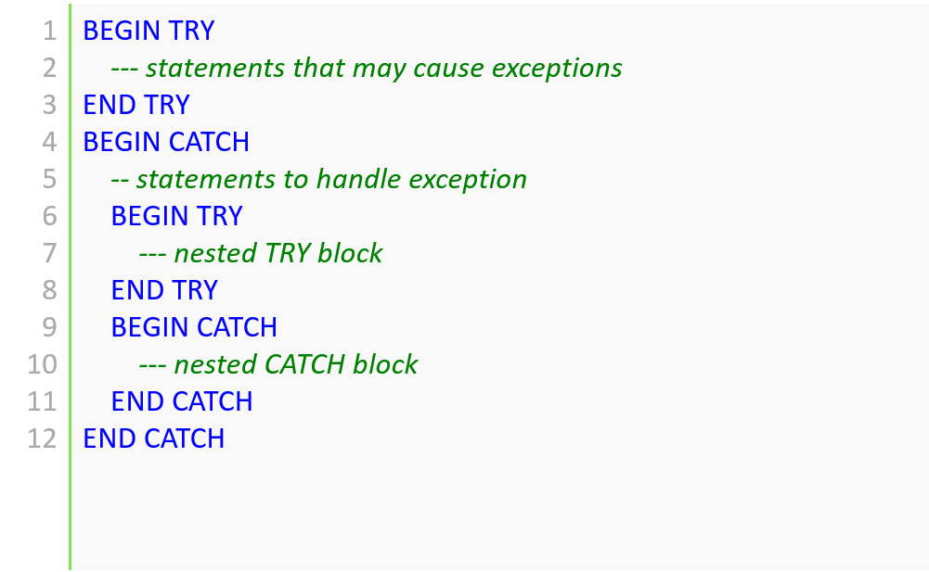
Handling Exceptions in Stored Procedure

Slide 22
The catch block functions.
Inside the CATCH block, you can use the following functions to get the detailed information on the error that occurred:
ERROR_LINE() returns the line number on which the exception occurred.
ERROR_MESSAGE() returns the complete text of the generated error message.
ERROR_PROCEDURE() returns the name of the stored procedure or trigger where the error occurred.
ERROR_NUMBER() returns the number of the error that occurred.
ERROR_SEVERITY() returns the severity level of the error that occurred.
ERROR_STATE() returns the state number of the error that occurred.

Slide 23
SP with TRY-CATCH
CREATE PROC usp_divide(
@a decimal,
@b decimal,
@c decimal output
) AS
BEGIN
BEGIN TRY
SET @c = @a / @b;
END TRY
BEGIN CATCH
SELECT
ERROR_NUMBER() AS ErrorNumber
,ERROR_SEVERITY() AS ErrorSeverity
,ERROR_STATE() AS ErrorState
,ERROR_PROCEDURE() AS ErrorProcedure
,ERROR_LINE() AS ErrorLine
,ERROR_MESSAGE() AS ErrorMessage;
END CATCH
END;
GO

Slide 24

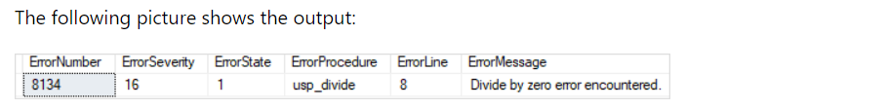
Execute SP with TRY-CATCH
call the usp_divide stored procedure to divide 10 by 2:
DECLARE @r decimal;
EXEC usp_divide 10, 2, @r output;
PRINT @r;
Here is the output:
attempt to divide 20 by zero by calling the usp_divide stored procedure:
DECLARE @r2 decimal;
EXEC usp_divide 10, 0, @r2 output;
PRINT @r2;

Slide 25
https://www.w3schools.com/sql/sql_stored_procedures.asp
References
https://learn.microsoft.com/en-us/sql/relational-databases/stored-procedures/create-a-stored-procedure
https://www.javatpoint.com/stored-procedure-in-sql-server
https://www.sqlshack.com/sql-server-stored-procedures-for-beginners/
https://www.tutorialsteacher.com/sqlserver/stored-procedures
https://www.c-sharpcorner.com/article/how-to-create-a-stored-procedure-in-sql-server-management-studio/
https://www.programiz.com/sql/stored-procedures

